Slide 1
k-Nearest Neighbors
Parinya Sanguansat

Slide 2
Look up Table
n | log(n)
1.00 | 0.00000000
1.01 | 0.00432137
1.02 | 0.00860017
1.03 | 0.01283722
1.04 | 0.01703334
log(1.01) = ?
log(1.03) = ?
log(1.035) = ?
Interpolation?

Slide 3

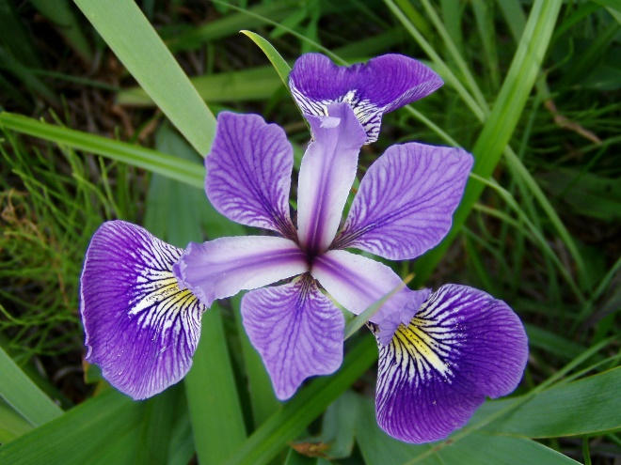

Iris Classification
Virginica
Versicolor
Setosa

Slide 4
Sample Space
3
5
2
1
4
6
X
7
X belongs to class ?
8
9

Slide 5
k-NN
k=1: X belongs to class ?
k=3: X belongs to class ?
k=6: X belongs to class ?
3
5
2
1
4
6
X
7
k=1
k=3
8
k=6
9
If k=1, we will call the nearest neighbor

Slide 6
k-NN Procedure
Collect data
Define the similarity measurement
Classify the new data by calculating the similarity from all collected data
Find the most similar one in the collected data
The class of the new data will be the same as the class of the most similar one

Slide 7
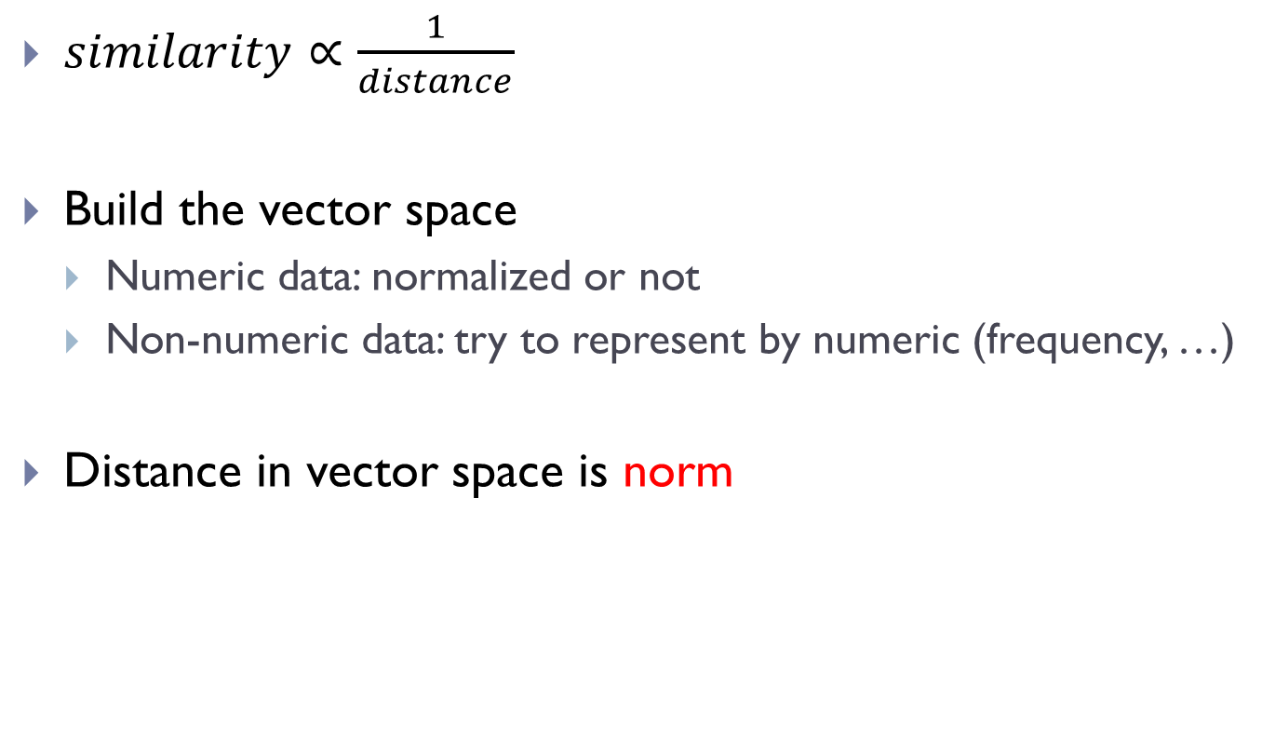
Similarity Measurement
$similarity∝\frac{1}{distance}$
Build the vector space
Numeric data: normalized or not
Non-numeric data: try to represent by numeric (frequency, …)
Distance in vector space is norm

Slide 8
Vector Length
In 2D/3D vectors, we can find the vector length by Properties
Multiplying a vector by a positive scalar changes its length without changing its direction.
The triangle inequality

Slide 9
Norm
The generalization of vector length in
More abstract, cannot illustrate if n > 3
Notation:
A vector space on which a norm is defined is then called a normed vector space.

Slide 10
L1-norm
Other names: Rectilinear/City block/Manhattan/Taxicab

Slide 11


L2-norm
Other names: Euclidean

Slide 12
L∞-norm
Other names: Uniform/Supremum/Chebyshev/Infinity

Slide 13
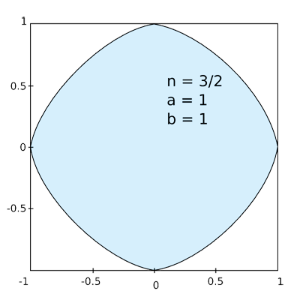
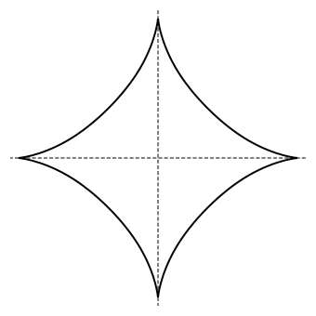
Lp-norm
Other names: p-norm
P = 3/2 p=2/3

Slide 14
Pros & Cons
Pros: High accuracy, insensitive to outliers, no assumptions about data, no training required
Cons: Computationally expensive, requires a lot of memory
Works with: Numeric values, nominal values

Slide 15
Condensed nearest neighbor (CNN)
Build prototype (sampling from the training set)
Almost as accurately as 1-NN
Given a training set X, CNN works iteratively:
Scan all elements of X, looking for an element x whose nearest prototype from U has a different label than x
Remove x from X and add it to U
Repeat the scan until no more prototypes are added to U

Slide 16
Border ratio
Order of training sample
X'
X
Y

Slide 17
K-d Tree
Reduce the number of comparisons
5
8
1
C
F
B
2
2
6
A
D
E
6
3
5
7
8
4
G
4
G
B
C
I
E
D
F
H
H
A
I
3
1
7

Slide 18




Locality-sensitive Hashing (LSH)
Dimension Reduction
Hash → Bit
B
1
 | 1 | 2 | 3 | Code
A | 1 | 1 | 0 | 6
B | 0 | 0 | 1 | 1
C | 0 | 1 | 1 | 3
3
A
C
2

